Slide 1
Afrizal Doewes
Arif Rohmadi
Cookies and Session

Slide 2
Cookies
A cookie is often used to identify a user.
A cookie is a small file that the server embeds on the user's computer. Each time the same computer requests a page with a browser, it will send the cookie too.

Slide 3
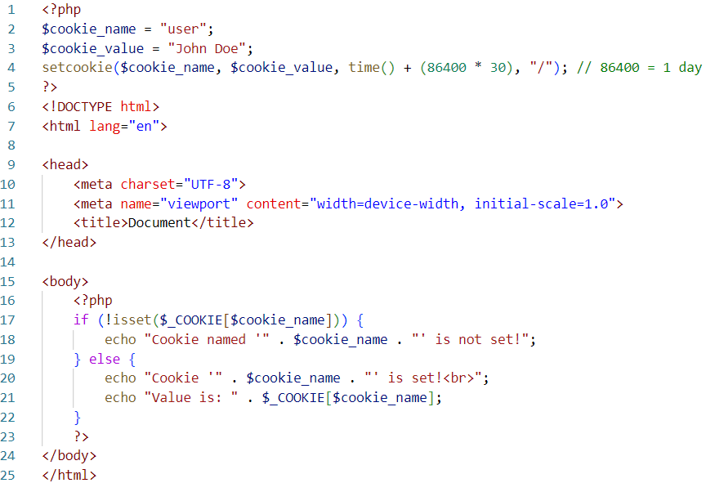
Create/Retrieve a Cookie

Slide 4
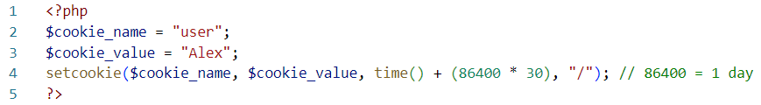
Modify a Cookie Value
To modify cookie just set again using the setcookie() function

Slide 5
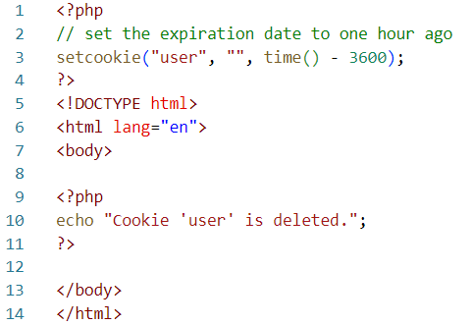
Delete a Cookie
To delete a cookie, use the setcookie() function with an expiration date in the past

Slide 6
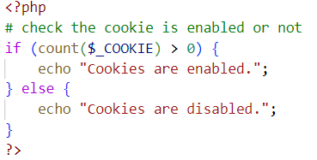
Check Cookies

Slide 7
Sessions
A session is a way to store information (in variables) to be used across multiple pages. Unlike a cookie, the information is not stored on the users computer, but on the server-side.
Session variables hold information about one single user, and are available to all pages in one application
How do PHP Sessions work?
Session Start: When a user accesses a PHP page, the session gets started with the session_start()
Session Variables: Data that needs to be carried across different pages is stored in the $_SESSION array
Session ID: PHP assigns a unique session ID to every user.
Session Data Storage: The session data is stored on the server, not the client side
Session Termination: Sessions can be terminated by calling session_destroy()

Slide 8

Starting a Session

Slide 9
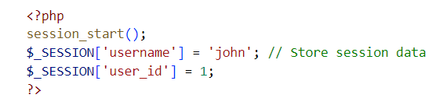
Storing data in Sessions

Slide 10
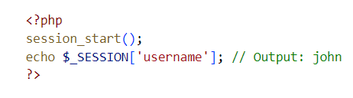
Retrieving Sessions Data

Slide 11
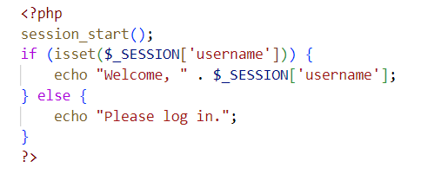
Checking if Session Variables Exist

Slide 12
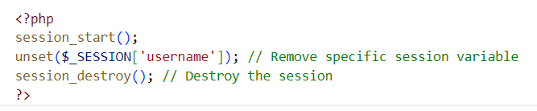
Destroying Sessions

Slide 13
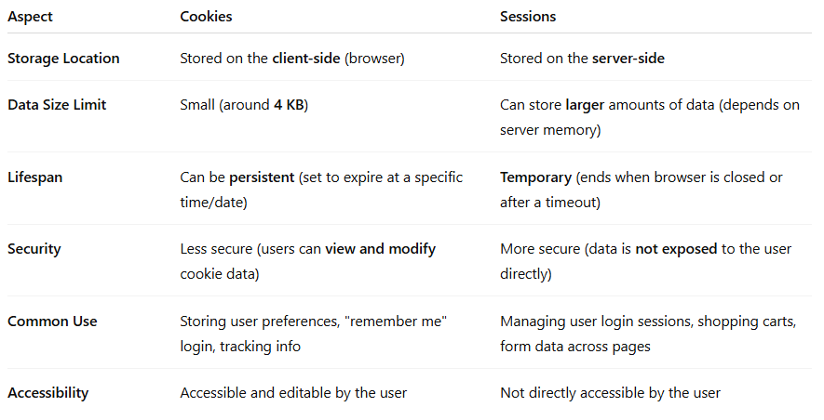
The Difference Between Cookies and Sessions

